Slide 1

ESTIMATING THE COMORBIDITY INDEX FOR VACCINE DISTRIBUTION STRATEGY FOR INDIA USING THE DISEASE DATA COLLECTED THROUGH WEB SCRAPING.
Information Systems Project - IM69004
Under the guidance of
Prof. M. Jenamani
&
Mr. Biswajit Kar
Department of Industrial and Systems Engineering,
Indian Institute of Kharagpur, West Bengal
: Presented By :
Pratik Akbari - 21IM60R01

Slide 2
OBJECTIVE
To Scrap the Driving Distance matrix and collect the regional data of comorbidity diseases responsible for higher mortality rate under pandemics – “Web Scraping”
To estimate a regional comorbidity index to understand the regional risk of mortality under pandemics.

Slide 3
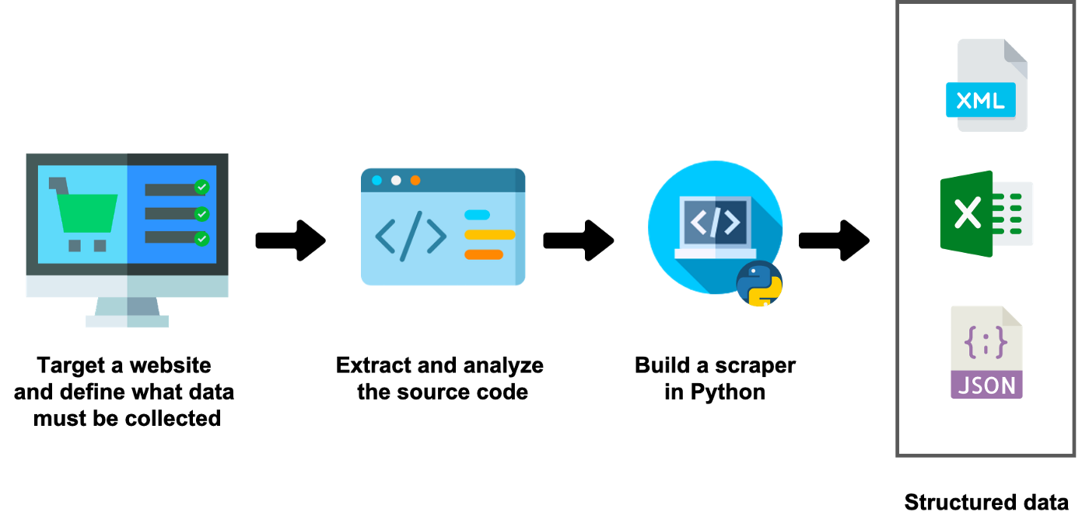



WEB SCRAPING
To extract the content and collect the data from any website.
Extract the large dataset from any website.
Python Library Used :

Slide 4
DRIVING DISTANCE(KM) MATRIX OF INDIA
STATES/UTs* | Andaman & Nicobar Islands | Andhra Pradesh | Arunachal Pradesh | Assam | Bihar | Chandigarh | Chattisgarh | Dadra & Nagar Haveli
Andaman & Nicobar Islands | 0 | 1471 | 1837 | 1601 | 1669 | 2665 | 1561 | 2298
Andhra Pradesh | 1471 | 0 | 2970 | 2516 | 1816 | 2114 | 905 | 1148
Arunachal Pradesh | 1837 | 2961 | 0 | 555 | 1465 | 2737 | 2209 | 3280
Assam | 1601 | 2514 | 566 | 0 | 1059 | 2331 | 1802 | 2874
Bihar | 1669 | 1819 | 1471 | 1059 | 0 | 1370 | 866 | 1762
Chandigarh | 2665 | 2113 | 2752 | 2340 | 1368 | 0 | 1462 | 1520
Chattisgarh | 1561 | 904 | 2214 | 1802 | 865 | 1465 | 0 | 1116
Dadra & Nagar Haveli | 2298 | 1150 | 3300 | 2888 | 1760 | 1530 | 1116 | 0
*UTs : Union Territories
Source:- Bings Map API key

Slide 5
2021 POPULATION DATA
SR. | STATES | TOTAL(‘000) | MEN(‘000) | WOMEN(‘000)
1 | Andaman & Nicobar Islands | 400 | 211 | 189
2 | Andhra Pradesh | 52787 | 26403 | 26384
3 | Arunachal Pradesh | 1533 | 789 | 745
4 | Assam | 35043 | 17843 | 17200
5 | Bihar | 1,23,083 | 64012 | 59071
6 | Chandigarh | 1208 | 654 | 554
7 | Chhattisgarh | 29493 | 14794 | 14698
8 | Dadra & Nagar Haveli | 608 | 363 | 245
9 | Daman & Diu | 469 | 330 | 140
10 | Delhi | 20571 | 10963 | 9609
11 | Goa | 1559 | 786 | 773
12 | Gujarat | 69788 | 36600 | 33188
13 | Haryana | 29483 | 15623 | 13860
14 | Himachal Pradesh | 7394 | 3750 | 3644
15 | Jammu & Kashmir | 13408 | 7030 | 6378
16 | Jharkhand | 38471 | 19701 | 18770
17 | Karnataka | 66845 | 33911 | 32934
18 | Kerala | 35489 | 17043 | 18447
19 | Lakshadweep | 68 | 35 | 33
Source:- https://nhm.gov.in/New_Updates_2018/Report_Population_Projection_2019.pdf

Slide 6
AVAILABLE DISEASES DATA
SR. | DISEASES | NFHS 3* (2005-06) | NFHS 4* (2015-16)
1 | DIABETES |  | 
2 | HEART DISEASES |  | 
3 | ASTHMA |  | 
4 | THYROID |  | 
5 | CANCER |  | 
6 | HYPERTENSION |  | 
7 | KIDNEY DISEASES |  | 
8 | RESPIRATORY |  | 
*NFHS : National Family Health Survey
Source : https://data.gov.in/

Slide 7
MISSING DATA VALUES
SR. | STATES/UTS | NFHS 3 (2005-06) |  |  | NFHS 4 (2015-16)
 | States/UTs | Diabetes | Asthma | Thyroid | Diabetes | Asthma | Thyroid
1 | Andaman & Nicobar Islands |  |  |  |  |  | 
2 | Chandigarh |  |  |  |  |  | 
3 | Dadra & Nagar Haveli |  |  |  |  |  | 
4 | Daman & Diu |  |  |  |  |  | 
5 | Lakshadweep |  |  |  |  |  | 
6 | Puducherry |  |  |  |  |  | 
7 | Telangana |  |  |  |  |  | 
… | …… | …… | …… | …… | …… | …… | ……
36 | All other states |  |  |  |  |  | 

Slide 8
MISING VALUE IMPUTATION IN 2005 DATA
SR. | STATES | DIABETES | ASTHMA | THYROID
1 | Andaman & Nicobar Islands | 420600 | 723102 | 287500
2 | Andhra Pradesh | 779785 | 1145482 | 523616
3 | Arunachal Pradesh | 8782 | 31524 | 19649
4 | Assam | 176380 | 439857 | 375348
5 | Bihar | 1206600 | 1629802 | 678628
6 | Chandigarh | 420600 | 723102 | 287500
7 | Chattisgarh | 234740 | 236580 | 135712
8 | Dadra & Nagar Haveli | 420600 | 723102 | 287500
9 | Daman & Diu | 420600 | 723102 | 287500
10 | Delhi | 297320 | 133249 | 156890
11 | Goa | 38555 | 26674 | 11091
12 | Gujarat | 513044 | 1182680 | 186982
13 | Haryana | 257011 | 412894 | 169231
14 | Himachal Pradesh | 51089 | 33755 | 36106
15 | Jammu and Kashmir | 53985 | 114575 | 15116
16 | Jharkhand | 246300 | 322504 | 175625
17 | Karnataka | 554235 | 648964 | 359460
18 | Kerala | 994798 | 1253269 | 1381368
19 | Lakshadweep | 420600 | 723102 | 287500
POPULATION
400000
52787000
1533000
35043000
123083000
1208000
29493000
608000
469000
20571000
1559000
69788000
29483000
7394000
13408000
38471000
66845000
35489000
68000
SR. | STATES | DIABETES | ASTHMA | THYROID
1 | Andaman & Nicobar Islands | 10124 | 21473 | 7323
2 | Andhra Pradesh | 779785 | 1145482 | 523616
3 | Arunachal Pradesh | 8782 | 31524 | 19649
4 | Assam | 176380 | 439857 | 375348
5 | Bihar | 1206600 | 1629802 | 678628
6 | Chandigarh | 9102 | 35742 | 13056
7 | Chattisgarh | 234740 | 236580 | 135712
8 | Dadra & Nagar Haveli | 9861 | 25146 | 8799
9 | Daman & Diu | 10037 | 22691 | 7813
10 | Delhi | 297320 | 133249 | 156890
11 | Goa | 38555 | 26674 | 11091
12 | Gujarat | 513044 | 1182680 | 186982
13 | Haryana | 257011 | 412894 | 169231
14 | Himachal Pradesh | 51089 | 33755 | 36106
15 | Jammu and Kashmir | 53985 | 114575 | 15116
16 | Jharkhand | 246300 | 322504 | 175625
17 | Karnataka | 554235 | 648964 | 359460
18 | Kerala | 994798 | 1253269 | 1381368
19 | Lakshadweep | 10544 | 15609 | 4968














1. K-Nearest Neighbour (KNN) Imputer
2. Linear Interpolation Technique

Slide 9
DISEASES DATA OF 2005
SR. | STATES | DIABETES | ASTHMA | THYROID | POPULATION
1 | Andaman & Nicobar Islands | 10124 | 21473 | 7323 | 400000
2 | Andhra Pradesh | 779785 | 1145482 | 523616 | 52787000
3 | Arunachal Pradesh | 8782 | 31524 | 19649 | 1533000
4 | Assam | 176380 | 439857 | 375348 | 35043000
5 | Bihar | 1206600 | 1629802 | 678628 | 123083000
6 | Chandigarh | 9102 | 35742 | 13056 | 1208000
7 | Chattisgarh | 234740 | 236580 | 135712 | 29493000
8 | Dadra & Nagar Haveli | 9861 | 25146 | 8799 | 608000
9 | Daman & Diu | 10037 | 22691 | 7813 | 469000
10 | Delhi | 297320 | 133249 | 156890 | 20571000
11 | Goa | 38555 | 26674 | 11091 | 1559000
12 | Gujarat | 513044 | 1182680 | 186982 | 69788000
13 | Haryana | 257011 | 412894 | 169231 | 29483000
14 | Himachal Pradesh | 51089 | 33755 | 36106 | 7394000
15 | Jammu & Kashmir | 53985 | 114575 | 15116 | 13408000
16 | Jharkhand | 246300 | 322504 | 175625 | 38471000
17 | Karnataka | 554235 | 648964 | 359460 | 66845000
18 | Kerala | 994798 | 1253269 | 1381368 | 35489000
19 | Lakshadweep | 10544 | 15609 | 4968 | 68000

Slide 10
DISEASES DATA OF 2015
SR. | STATES | DIABETES | ASTHMA | THYROID | POPULATION
1 | Andaman & Nicobar Islands | 16923 | 10404 | 5502 | 400000
2 | Andhra Pradesh | 1478112 | 1213968 | 1161010 | 52787000
3 | Arunachal Pradesh | 18408 | 11307 | 9072 | 1533000
4 | Assam | 368273 | 279701 | 345929 | 35043000
5 | Bihar | 1777292 | 1959446 | 1028912 | 123083000
6 | Chandigarh | 23206 | 7755 | 39580 | 1208000
7 | Chattisgarh | 191842 | 191458 | 205868 | 29493000
8 | Dadra & Nagar Haveli | 5590 | 5735 | 2450 | 608000
9 | Daman & Diu | 700 | 1450 | 610 | 469000
10 | Delhi | 385452 | 156452 | 443368 | 20571000
11 | Goa | 52954 | 11660 | 15486 | 1559000
12 | Gujarat | 800856 | 760844 | 405080 | 69788000
13 | Haryana | 230575 | 240909 | 383035 | 29483000
14 | Himachal Pradesh | 99554 | 55190 | 113388 | 7394000
15 | Jammu & Kashmir | 332082 | 148792 | 565970 | 13408000
16 | Jharkhand | 545111 | 407204 | 344377 | 38471000
17 | Karnataka | 1737970 | 731387 | 694545 | 66845000
18 | Kerala | 1526070 | 742287 | 1579421 | 35489000
19 | Lakshadweep | 1884 | 1443 | 2091 | 68000

Slide 11
LINEAR EXTRAPOLATED DISEASES DATA OF 2022
SR. | STATES | DIABETES | ASTHMA | THYROID | POPULATION
1 | Andaman & Nicobar Islands | 21682 | 2655 | 4227 | 400000
2 | Andhra Pradesh | 1966940 | 1261908 | 1607185 | 52787000
3 | Arunachal Pradesh | 25146 | -2844 | 1668 | 1533000
4 | Assam | 502598 | 167591 | 325335 | 35043000
5 | Bihar | 2176776 | 2190196 | 1274110 | 123083000
6 | Chandigarh | 33078 | -11835 | 58146 | 1208000
7 | Chattisgarh | 161813 | 159872 | 254977 | 29493000
8 | Dadra & Nagar Haveli | 2600 | -7852 | -1994 | 608000
9 | Daman & Diu | -5835 | -13418 | -4432 | 469000
10 | Delhi | 447144 | 172694 | 643902 | 20571000
11 | Goa | 63033 | 1150 | 18562 | 1559000
12 | Gujarat | 1002324 | 465558 | 557748 | 69788000
13 | Haryana | 212069 | 120519 | 532697 | 29483000
14 | Himachal Pradesh | 133479 | 70194 | 167485 | 7394000
15 | Jammu & Kashmir | 526749 | 172743 | 951567 | 13408000
16 | Jharkhand | 754278 | 466494 | 462503 | 38471000
17 | Karnataka | 2566584 | 789083 | 929104 | 66845000
18 | Kerala | 1897960 | 384599 | 1718058 | 35489000
19 | Lakshadweep | -4178 | -8473 | 77 | 68000

Slide 12
REGIONAL COMORBIDITY INDEX
METHOD : PRINCIPAL COMPONENT ANALYSIS
Statistical procedure that uses an orthogonal transformation.
In the Machine Learning, Used as a Part of preprocessing.
“Dimensionality Reduction Technique”.
New set of variables : Components of PCA

Slide 13
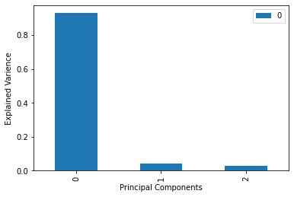
REGIONAL COMORBIDITY INDEX
PRINCIPAL COMPONENT ANALYSIS OF 2022 DISEASES DATA
 | 1st | 2nd | 3rd
Explained_Variance | 92.93 % | 4.19 % | 2.86 %

Slide 14
REGIONAL COMORBIDITY INDEX
1ST COMPONENT OF PCA
SR. | STATES | 1st PC
1 | Andaman & Nicobar Islands | -1.31057
2 | Andhra Pradesh | 1.859102
3 | Arunachal Pradesh | -1.31415
4 | Assam | -0.6809
5 | Bihar | 2.349266
6 | Chandigarh | -1.27316
7 | Chattisgarh | -0.93641
8 | Dadra & Nagar Haveli | -1.33331
9 | Daman & Diu | -1.34373
10 | Delhi | -0.47058
11 | Goa | -1.27685
12 | Gujarat | -0.01825
13 | Haryana | -0.72508
14 | Himachal Pradesh | -1.07825
15 | Jammu & Kashmir | -0.19351
16 | Jharkhand | -0.23291
17 | Karnataka | 1.382867
18 | Kerala | 1.317813
19 | Lakshadweep | -1.33609
SR. | STATES | C.I.
1 | Andaman & Nicobar Islands | 1.044287
2 | Andhra Pradesh | 5.27755
3 | Arunachal Pradesh | 1.039511
4 | Assam | 1.88525
5 | Bihar | 5.93219
6 | Chandigarh | 1.094258
7 | Chattisgarh | 1.543998
8 | Dadra & Nagar Haveli | 1.013927
9 | Daman & Diu | 1
10 | Delhi | 2.16614
11 | Goa | 1.089332
12 | Gujarat | 2.770253
13 | Haryana | 1.826242
14 | Himachal Pradesh | 1.354573
15 | Jammu & Kashmir | 2.536182
16 | Jharkhand | 2.483566
17 | Karnataka | 4.641515
18 | Kerala | 4.554632
19 | Lakshadweep | 1.010202
Normalized Data
from 1 to 10

Slide 15
CONCLUSION
I have finalized the web-scraping and collect state wise diseases data of 2022 as well as driving distance matrix of INDIA.
Successfully calculated the “regional comorbidity index” for the above.
To understand the severity of the underlying diseases.
For vaccine distribution strategy.

Slide 16

THANK YOU

